Slide 1
Martian Moons: Phobos, Deimos and the MMX Mission
Colin Leach

Slide 2
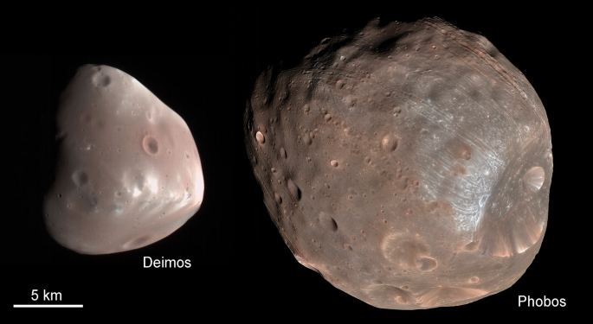
Phobos and Deimos
Irregular shapes
Deep, loose regolith
Deimos is smaller and smoother than Phobos
Phobos has grooves and one very large crater (Stickney)
Deimos and Phobos at the same scale in MRO HiRISE camera images. Colors are exaggerated, and albedos are brightened

Slide 3
Comparison of Mars & Earth Moons
 | Phobos | Deimos | Earth Moon
Body:
Size (km) | 26 x 23 x 18 | 15 x 12 x 10 | 3,474 (mean diam)
Bulk density (g/cm³⁾ | 1.860 ± 0.013 | 1.49 ± 0.19 | 3.344
Albedo | 0.071 | 0.068 | 0.136

Slide 4
Comparison of Mars & Earth Moons
 | Phobos | Deimos | Earth Moon
Body:
Size (km) | 26 x 23 x 18 | 15 x 12 x 10 | 3,474 (mean diam)
Bulk density (g/cm³⁾ | 1.860 ± 0.013 | 1.49 ± 0.19 | 3.344
Albedo | 0.071 | 0.068 | 0.136
Orbit:
Semimajor axis a | 9,377 km (2.8 R_{p}) | 23,460 km (7 R_{p}) | 384,399 km
Eccentricity e | 0.0151 | 0.0003 | 0.0549
Inclination i | 1.093° | 0.93° | 6.687°
Period | 7.66 h | 30.3 h | 765 h
Mars day (Sol) is 24.67 h

Slide 5
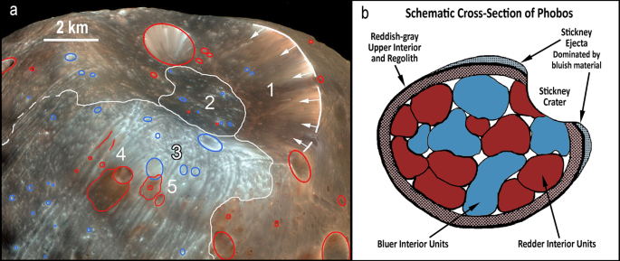
Surface Features & Spectra
Extensively cratered, though on Deimos the smaller craters are erased by regolith infill
Phobos has parallel grooves: cause unknown
Dark, with (mostly) red featureless spectrum (organics?)
Similar to D-type asteroids: extreme outer belt and Trojans
Composition similar to CM carbonaceous chondrites
Phobos also has “blue” units
Speculation this reflects internal heterogeneity (discrete blocks)
But small libration amplitude

Slide 6
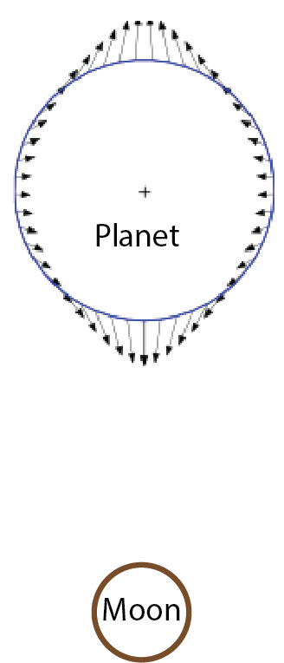
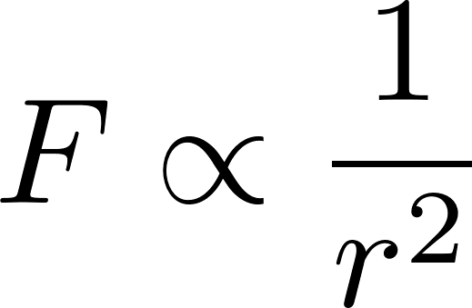
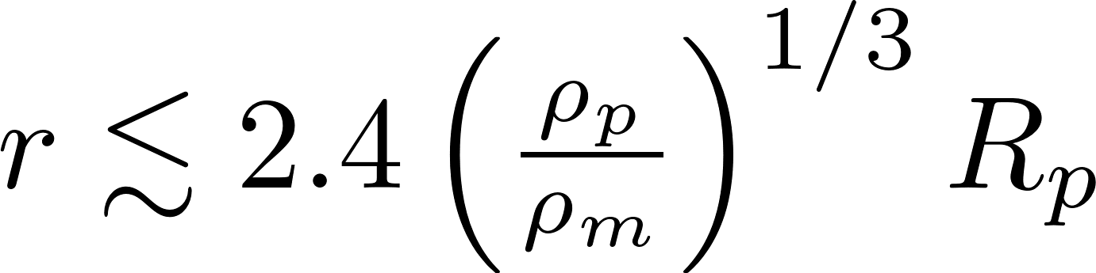
Tidal Effects: a Digression
Gradient in gravitational potential
Near side of body more strongly attracted than far side
Stretched along the planet-moon axis, squeezed perpendicular
Tides are a consequence of this – even in dry solids
Internal heating if effect is time-varying (elliptical orbit)
Tidal locking: same side always faces the planet
Roche limit: moon is disrupted if it approaches too close to the planet
Angular momentum transfer – next slide

Slide 7
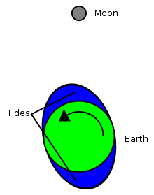
Deimos and Phobos Orbits
Very close to circular and equatorial for both (why?)
Radius changes with time
Tidal effects (as with Earth Moon)
High tide lags behind our Moon, because of viscosity
Asymmetry gradually slows the Earth’s rotation
Angular momentum transferred to the moon, which recedes
Deimos similar to Earth system: slowly receding
Phobos outpaces Mars rotation, orbit is decaying ~20 cm/yr
Phobos expected to reach the Roche limit in ~39 Myr
Is Phobos recent, or is seeing it near the end of its life just a coincidence?

Slide 8
Origins?
“the actual state of Martian moon science is based on a substantial underabundance of definitive evidence”
“many conclusions … are best understood as testable hypotheses rather than settled science”
Did the moons form in situ? Are they captured asteroids?
1. Capture of an asteroid (separately, or by fragmentation of a larger moon)
(a) Outer main belt or outer solar system body
(b) Inner solar system body
2. Formation near Mars
(a) Co-accretion with Mars
(b) Accretion disk from giant impact on Mars
Ramsley & Head (2021)

Slide 9
How does a planet capture an asteroid?
At approach, the asteroid is generally travelling (much) faster than the planet’s escape velocity (about 4.25 km/s for Mars)
Open, hyperbolic orbit (ellipticity > 1)
MUST lose kinetic energy to be captured in a closed orbit
Aero-braking
Hit the upper atmosphere at a glancing angle
ΔV enough for elliptical orbit, not enough to impact the planet
N-body dynamics
Interact with at least one other body, which carries away KE
BUT the orbit will be highly elliptical and probably highly inclined

Slide 10
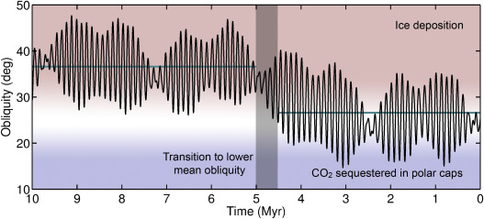
Orbits, Part 2
“Lowest energy” orbit is circular and equatorial
Relative to angular momentum
Circular, equatorial orbit implies substantial energy dissipation after capture
Mars obliquity currently 25°, similar to Earth (hence seasons)
BUT Mars is chaotic:
Range 0 – 60° over geological time
Substantial swings can be much faster
Moons seem able to track this, remaining equatorial

Slide 11
So, are they captured asteroids?
There are complex arguments for and against each hypothesis
No convergence towards a consensus opinion
WE NEED MORE DATA!
(of course)

Slide 12
JAXA Martian Moons eXploration Mission
Launch 2024, return 2029 : transit time about 1 year each way
Spend 3 years around Mars
Multiple fly-bys of both Phobos and Deimos
Drop a rover to the surface (free-fall then bounce!)
Touch-and-go to grab >10g of regolith and return it to Earth
https://www.mmx.jaxa.jp/en/

Slide 13
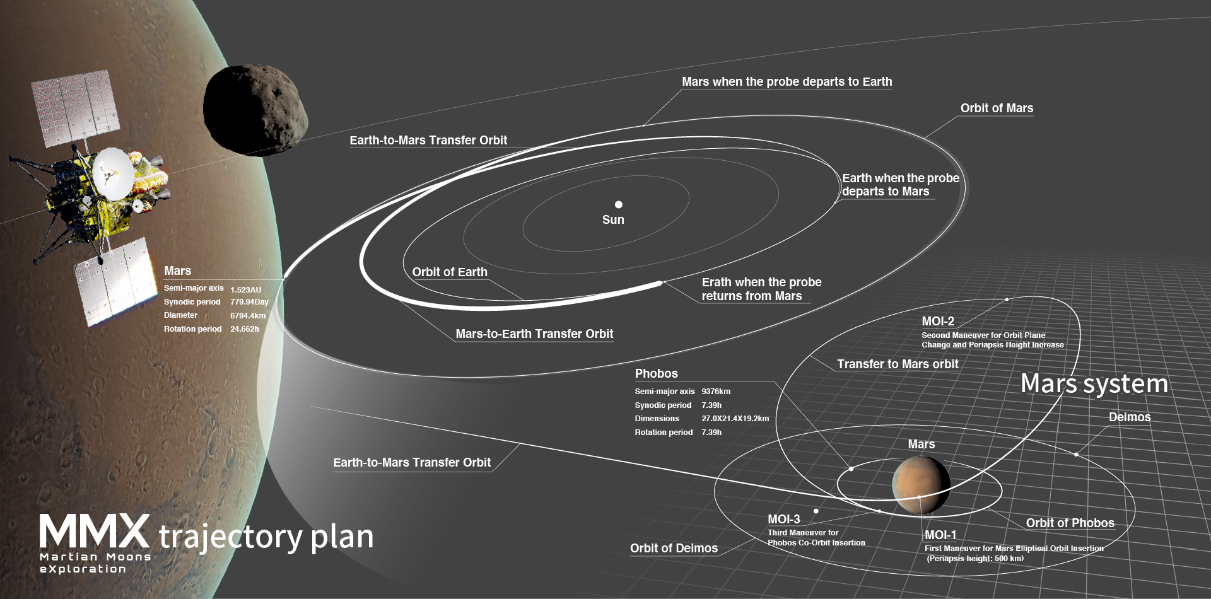
MMX Mission

Slide 14
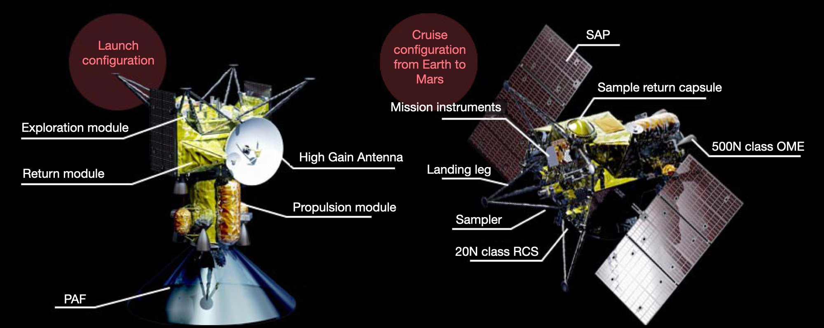
MMX Spacecraft

Slide 15

Instruments
TENGOO: narrow-angle camera
OROCHI: wide-angle camera
LIDAR: ranging, shape measurement
MIRS: IR spectrometer
MEGANE: -ray, neutron instrument
CMDM: dust monitor
MSA: mass spectrometer

Slide 16
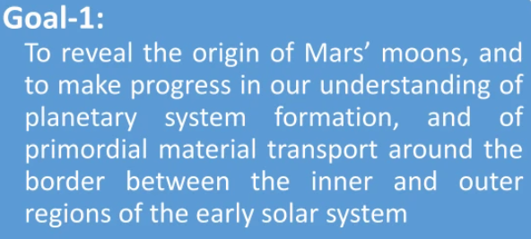
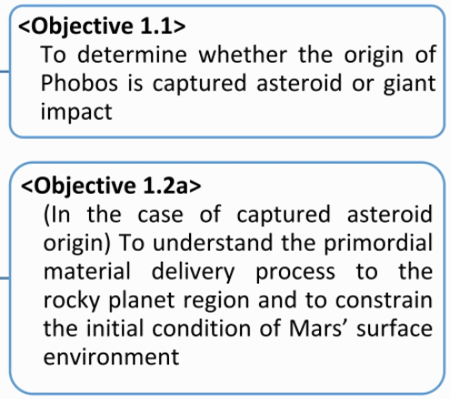
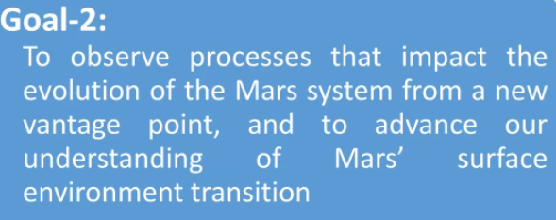
MMX Mission Objectives (subset)

Slide 17
Summary
The origin of Phobos and Deimos is an unsolved mystery
They are quite likely to be captured D-type asteroids
The MMX mission should finally cut through the confusion

